Slide 1

Governance Meeting

Slide 2
Click here to join the meeting
16th Sep 21 16:00 -17:00 HKT
16th Sep 2021

Slide 3
Agenda
Project Summary
WOS – Status Update
  Project Summary
  Deployment & CR progress
  Incident Statistics
  WAD - Outstanding Incidents
  Trucker and Spot App – Status Update
AOB

Slide 4
Project Summary
(Period: 18Aug21 to 16Sep21)
Highlights
WOS support activity and CRs are going on as per agreed schedule (Detailed Slide)
Previous meeting Action points (24th Aug21) | Prev Target | Status / Revised target
WorkAsDesign incidents discussion should be arranged with OSS regularly on priority and count of outstanding issues to be brought down to less than 10 | 28Nov18 | Ongoing Task

Slide 5
Maintenance items – Summary 2021
Quarter | Item | Status | Planned Date | Revised Date | Actual Date
Q1 | Archiving Health Check 2016 Shipment Archival Analysis complete. Target completion date is 30Nov21 for 2016 shipment Analysis Issues. Bugziila id - 24055. | Completed (2016 shipment Analysis Issues need to fix) | 31-Mar-21 | 31-May-21
Q1 | Sort out all problems / bugzilla issue under PENDING status | In Progress | 31-Mar-21 | 30-Sep-21
Q1 | Implementation of Automated Deployment | Completed | 31-Mar-21 | 31-May-21
Q2 | Archiving Health Check | Shipment Archival detail Analysis shared | 30-Jun-21 | 30-Sep-21
Q3 | Archiving Health Check |  | 30-Sep-21
Q4 | Archiving Health Check |  | 31-Dec-21

Slide 6
Maintenance items – Summary 2021 (Contd.)
S No. | Action Plan | Description
1. | 300K Shipment Archiving (without flight) | On 22Mar21 fix has been deployed on Production. Archiving of the pending shipment has been completed
2 | 140K Flight archiving | On 12Apr21 fix has been deployed on Production
2.1 |  | Daily Flight Archiving count set to 1800 flight.
2.2 | IN480881/PR102992 | There was an incident reported (IN480881) on 08Jun21 related to 01Jun21 deployment due to that currently daily archival count has been decreased from 130K per week to 20K-60K per week. Fix has been deployed on 30Jun21.
2.3 | Current Remaining Shipment | 725 K
2.4 | Target Completion | End of Oct’21
2.5 | Archival Status Email Job | Weekly job will send an email to pre-configured email ID’s listing daily archival job completion date time for previous week, count of archived flights and pending shipments to be archived. Bugzilla Id 23829 – Basic development completed & User specific changes would be require to do.
Notes:
For item 2.5, please short-list:those unclosed AWBs beyond 75 days
With inventory
Outstanding charges
Outstanding tracing record

Slide 7
Maintenance items – Summary 2021 (Contd.) - Aug 21

Slide 8
Maintenance items – Summary 2021 (Contd.) - Sep21

Slide 9
  WOS Status Update

Slide 10
WOS - Deployment & CR progress
Deployment Update (18Aug21 to 16Sep21)
2 Deployments in WOS Application during this period (1 deployment in Aug21, 1 deployment in Sep21)
These included –9 fixes (23Aug21) –10 fixes (06Sep21)

Slide 11
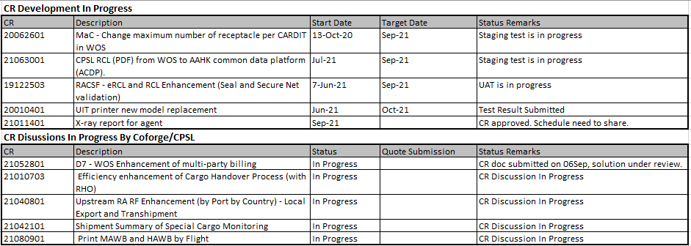
WOS - Deployment & CR progress

Slide 12
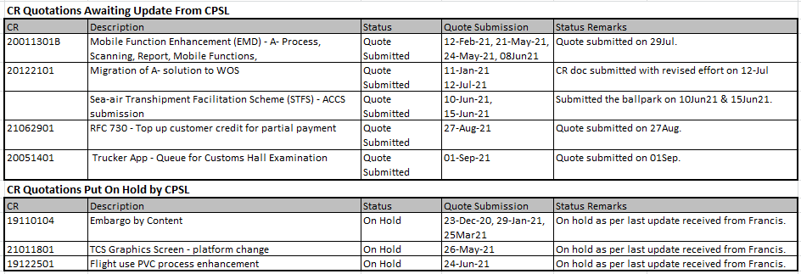
WOS - Deployment & CR progress

Slide 13

Monthly Statistics Analysis
Notes:
Please advise the status of below outstanding SR:
SR166453 WOS - WOS Data Patching - eSR 28781 - housekeep the data beyond 7-year retention
Please report the actual number of data patching done (including one related to“invalid” incidents).

Slide 14
Month wise Incidents Analysis

Slide 15
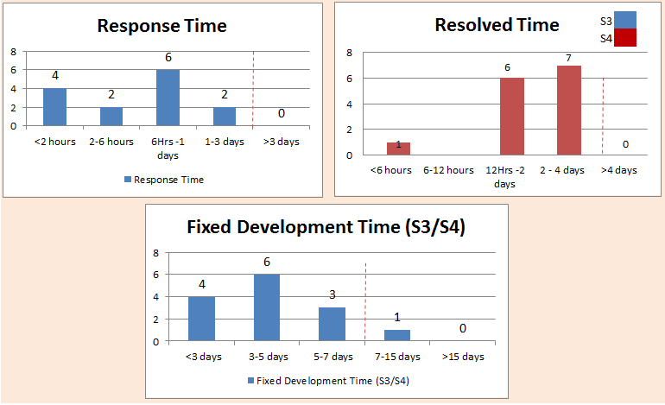
NIIT Resolution Statistics Aug’2021

Slide 16
Large Archive log usage issue
Background:
Original issue reported by CPSL was that the data replication to AWS was not happening fast enough due to the increased archival redo log file size due to numbers of insert/delete on SPL_CARGO_DASHBOARD table. After deployment of PR102900 (Dashboard Revamp) on 29Apr21, there is no insert/delete on SPL_CARGO_DASHBOARD table as the table has been removed. But its reported that the size of the archival redo log file did not reduce much.
After the deployment of 29 Apr 21, the size of archival redo log file dropped by 16%.
The archival file log size (with archiving job stopped) is still more than 63% over that before special cargo handling module deployment date - 29 Dec 21.
The archiving process is taking around 20% size of the total archiving log.
Log miner has been performed on production by IBM.
  Based on the IBM Log miner report, Coforge has identified the issue. Materialized view generating the archiving log. After further working with IBM. Coforge is evaluating 2 proposed below below.
  Option 1: Update the Materialized view to Fast refresh so that it will have only update for changed data.
  IBM Response: oracle materialized view fast refresh model can't support complex sub-query.
  Option 2: Upon every refresh Materialized View delete and inserts complete data. Usage of Materialized View is only for inventory view of Dashboard.
  Currently, Materialized View refreshes in one minute. This refresh can be changed to 5 minutes.
  Update: CPSL IM is working with IBM on the same.

Slide 17
KPI (Year 2021)
KPI in 2021 |  |  | 2021 (upto last month) | 2021 Target | 2021 Health
Number of A cases / number of deployment: x1/y , where: |  | x1 | 5 | 9 | G
 | y = number of deployment | y | 17 | 22
 | y1 = number of scheduled deployment | y1 | 15 | 22
2. Number of B cases / number of deployment: x2/y, where: |  | x2 | 0 | 1 | G
 | y = number of deployment | y | 17 | 22
 | y1 = number of scheduled deployment | y1 | 15 | 22
3. No S1 and S2 incidents from CR / Bug fix: x3 |  | x3 | 0 | 0 | G
4. Timely RCA and Sharing with NIIT teams and BAs: within 3 days (with quarterly review) |  | -
- Number of RCA and sharing within 3 days: x4/z , where z = total number of RCA |  | x4 | 4 | 100% | R
 |  | z | 7
5. Average SR/data patch per month |  |  | 7 | 9 | G
6. No of outstanding Invalid Incidents for discussion |  |  | 10 | <10 | G
7. No. of important OPS incidents (e.g. S3 incident in DM report) |  |  | 0 | 8 | G
8. No. of "cannot replicate" valid incidents |  |  | 0 | 8 | G
9. No. of outstanding valid side-walk bugs to be fixed |  |  | 18 | <10 | R
10 No. of problem and side-walk bugs issues for discussion |  |  | 4 | <10 | G

Slide 18
Outstanding Incidents
  Progress
  Summary of discussions with IMT & OSS
  No of Outstanding Incidents for discussion: 10
  New incident added after last meeting : 21
  Note: Both “Work-As-Design” and “No Action” incidents are part of the issues
Date | No of Incidents carry forwarded as per previous meeting | No of Incidents added new | Incidents cancelled | Incident under further investigation | Incidents accepted by NIIT for fixing
03Sep21 | 8 | 7 | 0 | 10 | 5

Slide 19
Trucker and Spot App – Status Update
  Number of incident– 0
    No incidents reported Aug21
  CR’s in progress
    CR:
      CR20051401 Trucker App - Queue for Customs Hall Examination –
        CR quote submitted on 01Sep
  Other On going Tasks
    SAN Certificates Domain Name (Production and Non-Production)
      Under discussion with IM
    Annual version upgrade (IOS / Android)
      Latest OS support in both android and iOS versions of trucker app, So no need of any version upgrade is required. However, Coforge checking further OS upgrade in 2021:
        Android 12
        IOS 15

Slide 20
  Next Meeting – 14Oct21 02:30 – 03:30 PM HKT
AOB

Slide 21
Thank You

